Slide 1
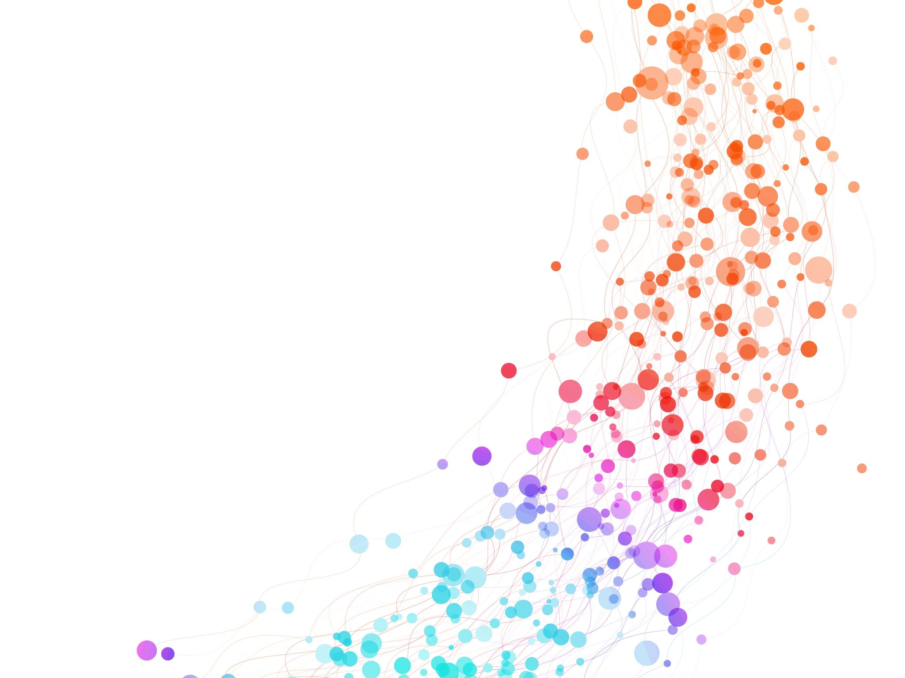
Data Analysis for SportsStats
Data Analysis Project Proposal for Olympics Dataset
Noviembre / 2021
Emer Isau Morales Vega

Slide 2
Overview
The data used for this analysis is the "SportsStats (Olympics Dataset - 120 years of data)" data set.
This dataset is made up of two files: athlet_events.csv and noc_regions.csv.
This data set was chosen because it reveals the Olympic medal award records for different sports categories, the countries that participated, names of the athletes, age, medals, etc.
Likewise, it can be said that the data is useful for news agencies that report on the different feats in the 120 years of the existence of the Olympic games.
Also, it can be of great importance for countries aspiring to improve their performance in subsequent Olympic events.

Slide 3
Section 1: Questions to Answer
Does the age of an athlete influence the performance for the delivery of a medal?
Which sporting event gathered the most athletes?
In which year were the most gold medals awarded?
In the 120 years of the Olympic Games, which country's team won the most medals?
Which sport wins the most gold medals?

Slide 4
Section 2: Initial Hyphothesis
Does the age of an athlete influence the performance for the delivery of a medal?
Which sporting event gathered the most athletes?
In which year were the most gold medals awarded?
In the 120 years of the Olympic Games, which country's team won the most medals?
Which sport wins the most gold medals?

Slide 5



Section 3: Data analysis Approach
The working environment will be in google colab with the python programming language and sqlite will be used to analyze the data.
In the first instance, the files athlet_events.csv and noc_regions.csv that are related through the NOC column will be loaded. That is, the column exists in both files.
Then it will be necessary to remove or replace the NA values ​​for better analysis.
Finally, to answer the questions posed, statistical inference and graphic visualization will be used to determine if there is a relationship between the columns.

